Slide 1

Programming Project: Syntax analyzer

Slide 2

Grammar Rules
var_dec:data_type dec ;
data_type:boolean | float | int | String | byte | long | short
dec:identifier [=exp] | identifier, dec
exp:exp (+|*|/|-) exp | ( exp ) | a-z-A-Z [exp] | 0 - 9 [exp] | " exp " | 0 - 9 . exp
identifier:(a-z-A-Z) [a-z-A-Z-0-9_]

Slide 3
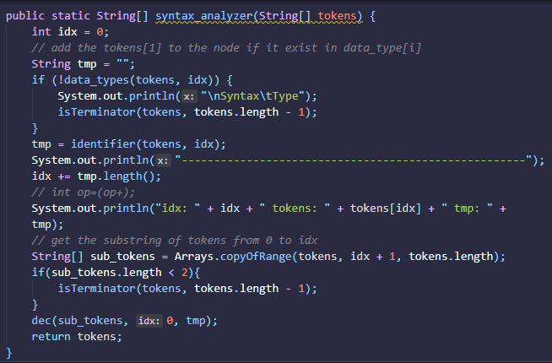
Main
Main Points:
If the data_types function return false then we would check if last index is terminator else exit the program.

Slide 4
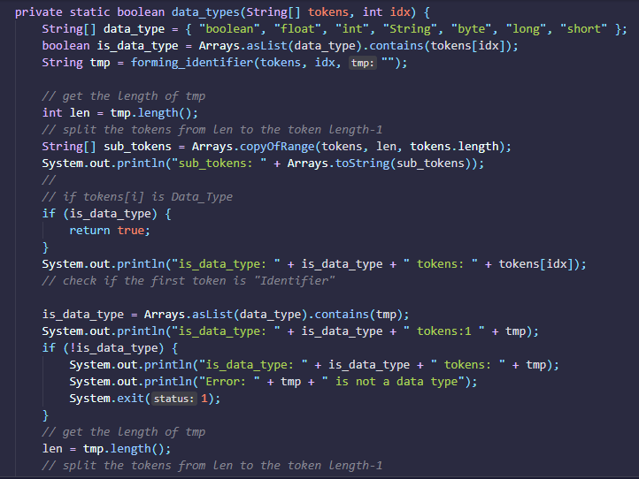
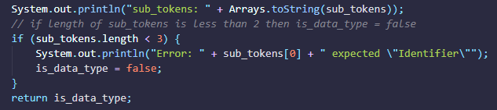
Data types

